Slide 1
SyriaTel Customer Churn Prediction
Building a predictive model to reduce customer churn and maximize retention.

Slide 2
Business Context
Churn leads to revenue loss and increased acquisition costs. Understanding churn patterns enables SyriaTel to implement targeted retention strategies, improving long-term customer value and profitability.

Slide 3
Business Problem
SyriaTel, a telecommunications company, faces significant customer churn. Our goal is to build a classifier to predict whether a customer will leave soon, allowing the company to take proactive measures to retain them.

Slide 4
Business and Data Understanding
Business Problem:
Identify customers likely to churn and take targeted actions.
Why Machine Learning?
Traditional retention methods are inefficient.
Data Used:
- Demographics
- Service usage
- Historical churn labels.

Slide 5
How Classification Helps
Classification models categorize customers into:
- **Likely to Stay**- False
- **Likely to Leave** - True
This helps Syria Tel take proactive actions to retain customers before they leave.

Slide 6
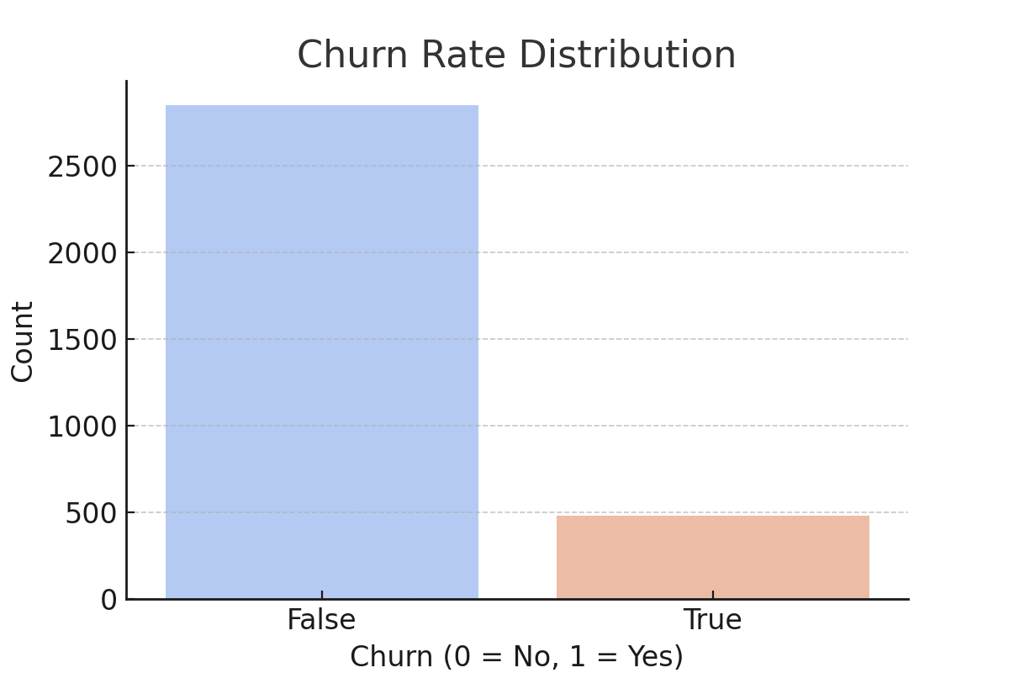
Churn Rate Distribution

Slide 7
Modeling Approach (Non-Technical)
We tested different models:
- **Logistic Regression**: Basic but interpretable.
- **Decision Trees**: Identifies key factors leading to churn.
- **Random Forest**: More advanced with higher accuracy.
- **SMOTE**: Ensures fairness in predictions.
- **Hyperparameter tuning**: Optimizes performance.

Slide 8
Understanding Model Performance
Metrics Explained in Plain Language:
- **Accuracy**: How often predictions are correct.
- **Precision**: Focuses on correctly identifying real churners.
- **Recall**: Ensures we catch as many churners as possible.
- **F1-score**: Balances precision and recall.

Slide 9
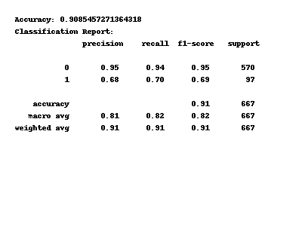
Random Forest Model Metrics

Slide 10
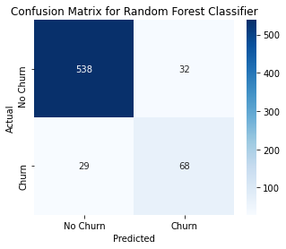

Slide 11
Key Findings
Best Model: **Random Forest**
Top Churn Indicators:
- High service usage
- International plans
- Frequent customer support calls
**Implication:** These groups need targeted interventions.

Slide 12
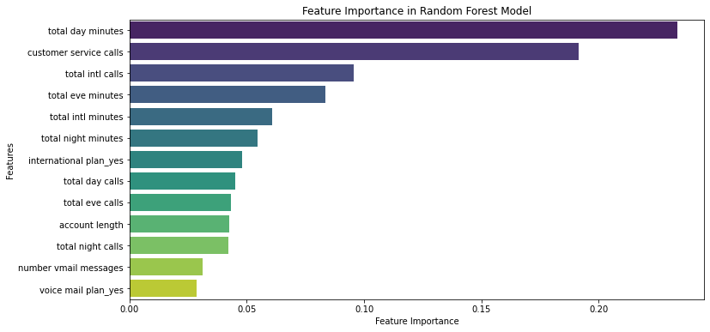
Top Churn Indicators

Slide 13
Recommendations
1. Implement personalized retention offers for high-risk customers.
2. Improve customer experience with proactive support and incentives.
3. Use data-driven insights to refine loyalty programs.
4. Continuously monitor and adjust churn prediction models for optimal accuracy.

Slide 14
Next Steps
1. Deploy the best model.
2. Continuously update with new data.
3. Conduct A/B testing for retention strategies.

Slide 15
Thank You!
Looking forward to discussing the insights and next steps.
Feel free to reach out on;
LinkedIn: Betsy Gitije
GitHub: BetsyGitije

